Slide 1
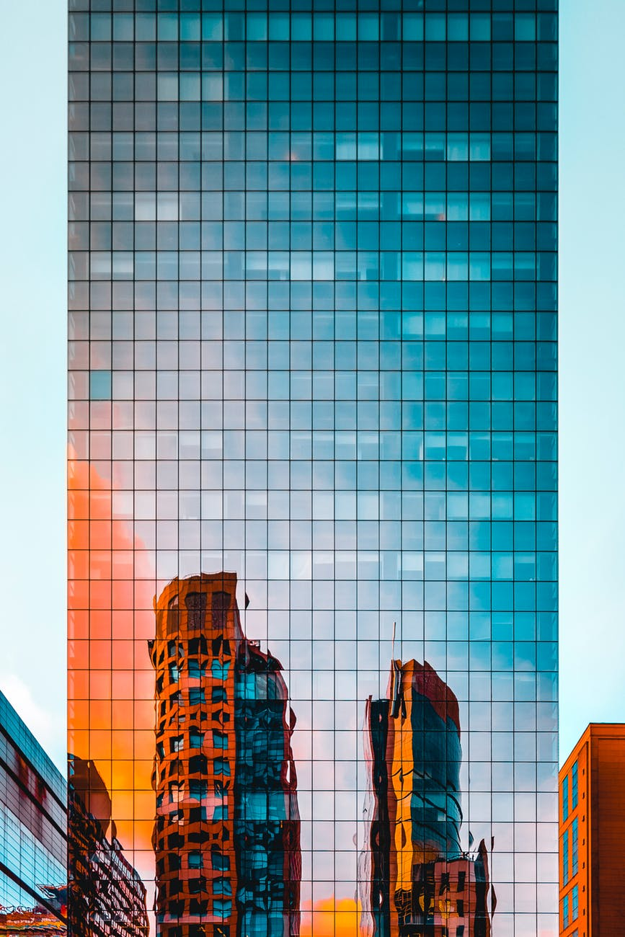
Tianjin
_{An Overview.}
A presentation of the general overview of Tianjin Municipality.
Name ：伊曼沙
Date：2021/09/23

Slide 2
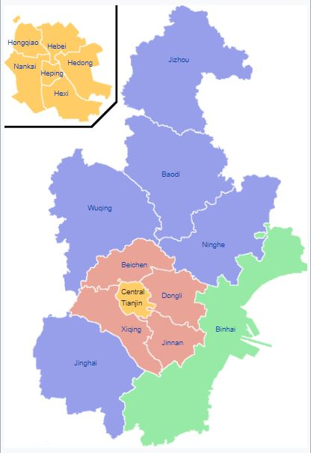
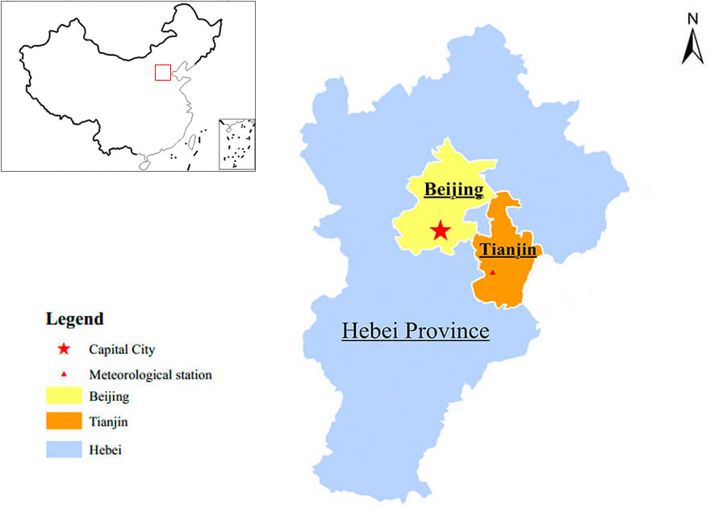
Key Facts Information & HISTORY
Tianjin, one of the four municipalities directly under the Central Government in China, is located in the northeast of the North China Plain and is the closest seaport to Beijing.
The city is one of the biggest industrial and port cities in China and is also known as 'the diamond of the Bohai Gulf'.

Slide 3
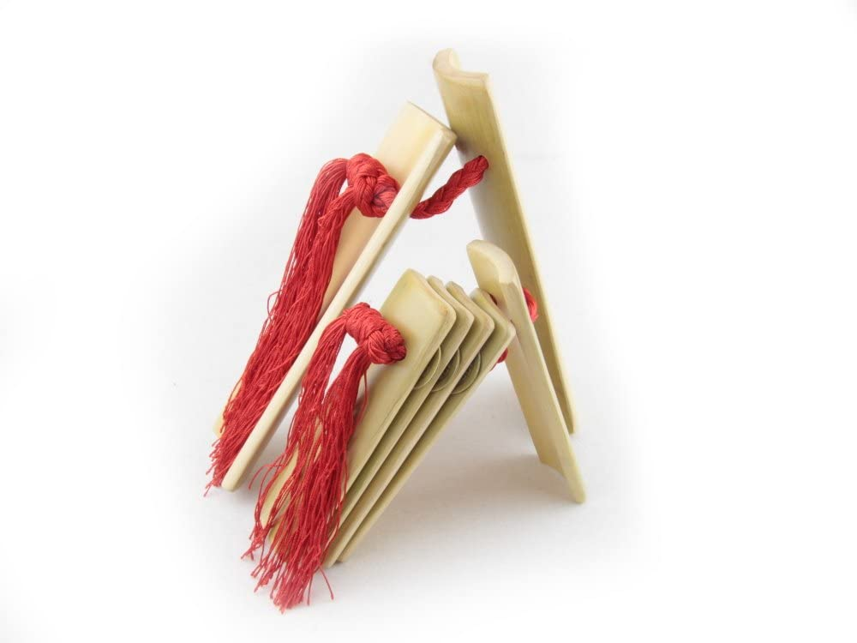
Tianjin is an unusual city in China. Despite its long Chinese history, it but was once a treaty port shared by nine countries: Italy, Germany, France, Great Britain, Russia, Austria, Japan, and Belgium. These circumstances have resulted in a city with a truly international flavor, with European-style buildings and mansions rubbing shoulders with historical, traditional Chinese buildings. Tianjin created a uniquely compatible urban style, Chinese and Western, ancient and modern.
Tianjin Culture & People
Tianjin dialect sounds quite different from Beijing dialect, which provides the basis for Putonghua, the official spoken language of the People's Republic of China.
Tianjin is a respected home of Beijing opera, It is famous for its stand-up
comedy and comedians such as Guo Degang and Ma Sanli.
Tianjin's patented brand of stand-up also includes
the use of rhythmic bamboo clappers known as "kuaiban".

Slide 4
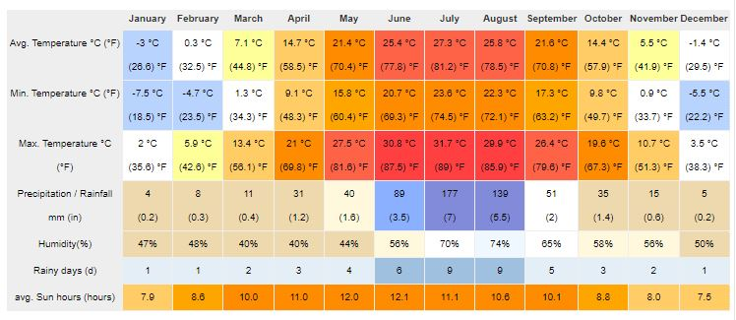
CLIMATE
Spring - is short in Tianjin, starts in March and lasting only 50 to 60 days.
Summer - in Tianjin starts in June. It is quite comfortable in June because even with a high temperature, the humidity is low.
Autumn - is only 60 days in Tianjin, and goes from mid-August to mid-October.
Winter -The average temperature in the winter is -4 °C (23 °F). Winter in Tianjin can even last for over 160 days.

Slide 5
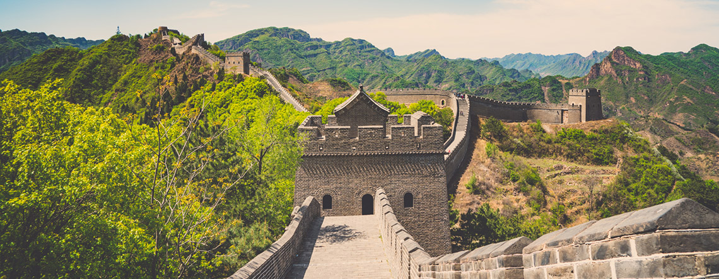
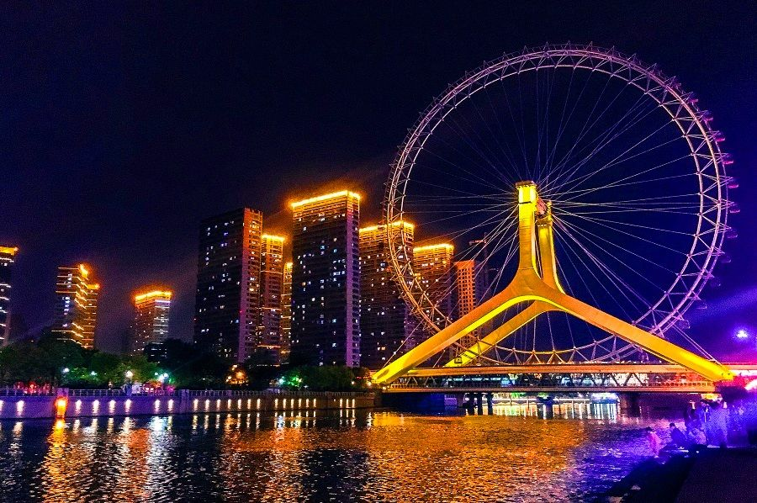
Attractions
★ Tianjin Eye is a 120-meter-high
ferris wheel. Its full name is Yongle
Bridge Tianjin Eye because it is
built on that bridge over the Hai
River.
★Huangyaguan Great Wall was originally built over 1400 years ago in the Northern Qi Dynasty and reinforced with brick walls in the Ming Dynasty.

Slide 6
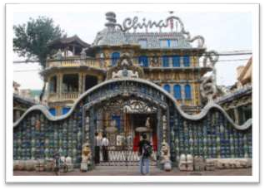
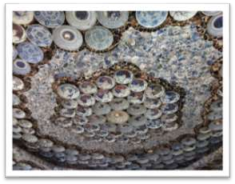
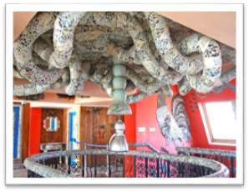
China House
China House
is a Porcelain House which is
decorated with about 4,000 pieces of ancient porcelain, 400 pieces of jade stone carving, 20 tons of crystal and with about million pieces of ancient Chinese ceramic chips.

Slide 7
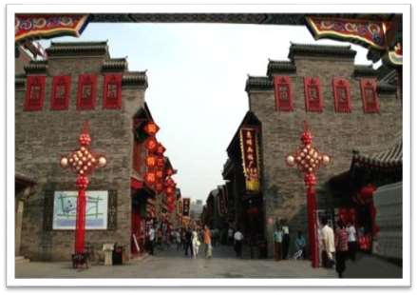
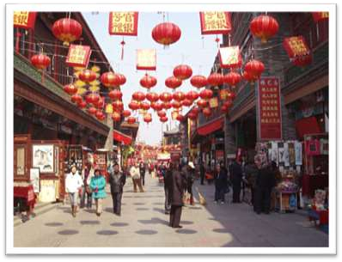
Tianjin Ancient Culture Street
Ancient Cultural Street is located in the Nankai District of the Tianjin Municipality. It is located on the west bank of the Haihe River, with Tianhou Palace as its geographical center.

Slide 8
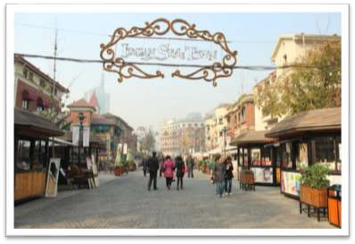
New Style Town
Tianjin Xin Yi Street is also known as the Italian Custom Area which was built during 1902. It covers the area from Coast area to the Victory Road.

Slide 9
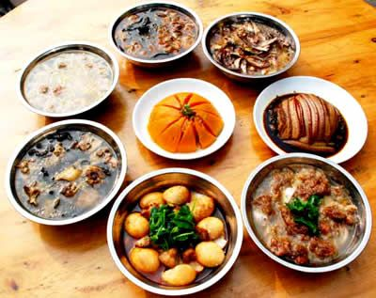
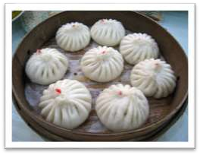
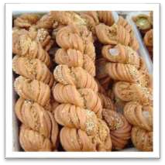
Food
Tianjin has a very famous food culture, and many people travel to Tianjin expect to taste these delicacies in Tianjin. Cuisines in Tianjin mainly includes river products and sea food.
gǒu bù lǐ bāo zǐ
Eight Great Bowls and Four Great Stews, actually referring to a very large number of stews, including chicken, duck, seafood, beef, and mutton.
Guifaxiang Mahua

Slide 10
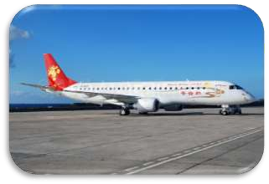
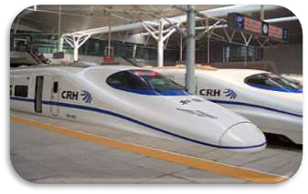
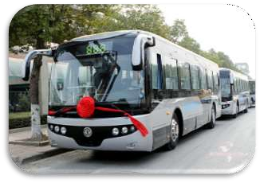
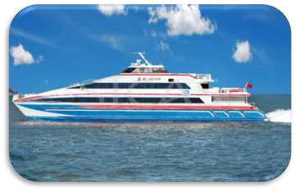
Transportation
Air
Railway
Coach / Bus
Waterway

Slide 11
THANK YOU
Name ：伊曼沙
Date：2021/09/23

